Slide 1




Animal cards
Illustrated vocabulary to cut out
Contents:
· 36 vocabulary cards to cut out
· A4 format, 12 cards per page
· Suggested age: 3-8 years
Print on A4 and cut along the dotted lines. Recommended: laminate to reuse.
Illustrations: Twemoji (github.com/jdecked/twemoji) · CC BY 4.0 licence: creativecommons.org/licenses/by/4.0/

Slide 2
Guide for teachers and families
WHO IT IS FOR
Preschool and early primary (ages 3-8). Also for newcomer classes and vocabulary support.
GOALS
· Grow animal vocabulary in English.
· Match picture and written word (whole-word reading).
· Build fluency in spoken language.
ACTIVITIES WITH PROGRESSION
Starter level
Show the card and name the animal. The children repeat. Then show only the word and ask which animal it is.
Intermediate level
Memory game: print two copies and play matching picture-word pairs. Or sort by habitat, size or diet.
Advanced level
Describe an animal without naming it and the children guess it. Or write simple sentences with three cards picked at random.
Print on A4, cut along the dotted lines and laminate the cards to reuse them. Cardstock keeps them sturdier.
Illustrations: Twemoji (github.com/jdecked/twemoji) · CC BY 4.0 licence: creativecommons.org/licenses/by/4.0/

Slide 3
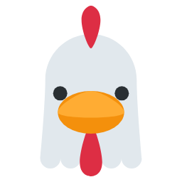

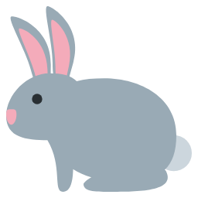



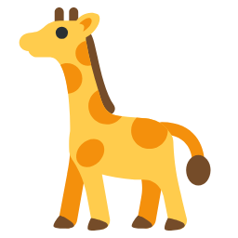

cat
dog
cow
pig
hen
duck
rabbit
fox
lion
elephant
giraffe
zebra
Illustrations: Twemoji (github.com/jdecked/twemoji) · CC BY 4.0 licence: creativecommons.org/licenses/by/4.0/

Slide 4






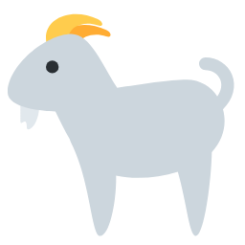

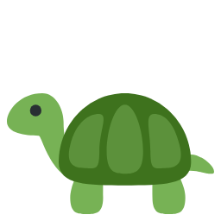



monkey
panda
bear
tiger
horse
sheep
goat
frog
turtle
fish
dolphin
whale
Illustrations: Twemoji (github.com/jdecked/twemoji) · CC BY 4.0 licence: creativecommons.org/licenses/by/4.0/

Slide 5



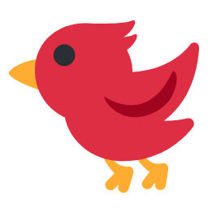



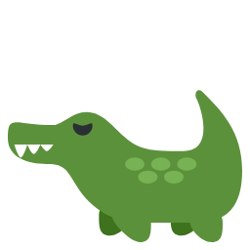



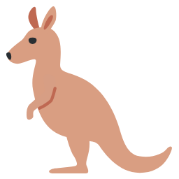
octopus
butterfly
bee
bird
penguin
owl
snake
crocodile
hedgehog
squirrel
mouse
kangaroo
Illustrations: Twemoji (github.com/jdecked/twemoji) · CC BY 4.0 licence: creativecommons.org/licenses/by/4.0/

