Slide 1

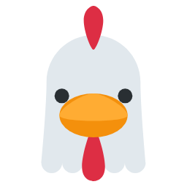


Animal bingo
30 unique cards with picture and word
Contents:
· 30 different cards
· Calling cards for the words
· 2 cards per A4 page to cut out
Print on A4 and cut along the dotted lines. Recommended: laminate to reuse.
Illustrations: Twemoji (github.com/jdecked/twemoji) · CC BY 4.0 licence: creativecommons.org/licenses/by/4.0/

Slide 2
Guide for teachers and families
WHO IT IS FOR
The whole class (ages 3-8). All 30 cards are different: nobody has the same card.
GOALS
· Reinforce animal vocabulary by listening.
· Train attention and active listening.
· Practise game rules and taking turns.
ACTIVITIES WITH PROGRESSION
Starter level
Call the cards while showing the picture. The children mark with counters, beans or lids.
Intermediate level
Call only the word, without showing the picture. Whoever completes a row and then the full card wins.
Advanced level
Let the children call the cards. Or play with definitions: instead of the word, describe the animal.
Print on A4 (2 cards per page), cut in half and laminate. Reusable all year with counters or beans.
Illustrations: Twemoji (github.com/jdecked/twemoji) · CC BY 4.0 licence: creativecommons.org/licenses/by/4.0/

Slide 3



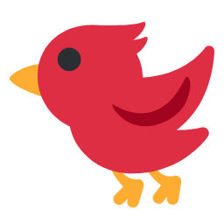





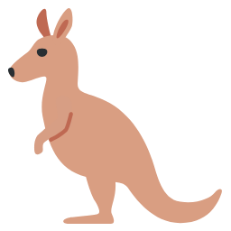
Animal bingo · card 1 / 30
dog
hen
zebra
monkey
horse
frog
octopus
bird
hedgehog
Animal bingo · card 2 / 30
duck
monkey
horse
fish
dolphin
octopus
hedgehog
mouse
kangaroo
Illustrations: Twemoji (github.com/jdecked/twemoji) · CC BY 4.0 licence: creativecommons.org/licenses/by/4.0/

Slide 4


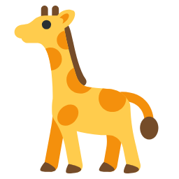







Animal bingo · card 3 / 30
lion
elephant
giraffe
zebra
sheep
bird
snake
crocodile
kangaroo
Animal bingo · card 4 / 30
cow
pig
hen
elephant
horse
whale
bee
bird
crocodile
Illustrations: Twemoji (github.com/jdecked/twemoji) · CC BY 4.0 licence: creativecommons.org/licenses/by/4.0/

Slide 5

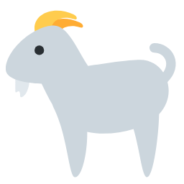
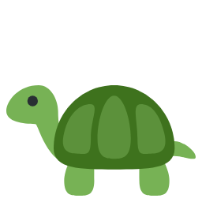


Animal bingo · card 5 / 30
dog
duck
fox
lion
giraffe
sheep
goat
fish
whale
Animal bingo · card 6 / 30
dog
pig
monkey
frog
turtle
bird
penguin
owl
kangaroo
Illustrations: Twemoji (github.com/jdecked/twemoji) · CC BY 4.0 licence: creativecommons.org/licenses/by/4.0/

Slide 6




Animal bingo · card 7 / 30
dog
duck
fox
monkey
tiger
sheep
fish
crocodile
squirrel
Animal bingo · card 8 / 30
cat
cow
pig
zebra
panda
tiger
horse
dolphin
hedgehog
Illustrations: Twemoji (github.com/jdecked/twemoji) · CC BY 4.0 licence: creativecommons.org/licenses/by/4.0/

Slide 7

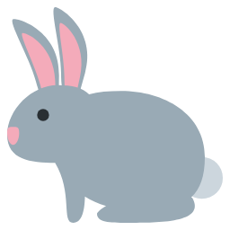
Animal bingo · card 9 / 30
pig
duck
giraffe
zebra
bear
horse
goat
whale
squirrel
Animal bingo · card 10 / 30
duck
rabbit
fox
bear
horse
frog
fish
bee
owl
Illustrations: Twemoji (github.com/jdecked/twemoji) · CC BY 4.0 licence: creativecommons.org/licenses/by/4.0/

Slide 8
Animal bingo · card 11 / 30
pig
lion
elephant
sheep
frog
bee
penguin
squirrel
mouse
Animal bingo · card 12 / 30
hen
duck
fox
lion
panda
tiger
horse
octopus
kangaroo
Illustrations: Twemoji (github.com/jdecked/twemoji) · CC BY 4.0 licence: creativecommons.org/licenses/by/4.0/

Slide 9

Animal bingo · card 13 / 30
hen
lion
zebra
turtle
dolphin
octopus
butterfly
penguin
squirrel
Animal bingo · card 14 / 30
pig
rabbit
elephant
sheep
turtle
fish
whale
octopus
mouse
Illustrations: Twemoji (github.com/jdecked/twemoji) · CC BY 4.0 licence: creativecommons.org/licenses/by/4.0/

Slide 10
Animal bingo · card 15 / 30
dog
hen
monkey
tiger
butterfly
bird
crocodile
hedgehog
kangaroo
Animal bingo · card 16 / 30
cat
duck
fox
elephant
bear
penguin
hedgehog
mouse
kangaroo
Illustrations: Twemoji (github.com/jdecked/twemoji) · CC BY 4.0 licence: creativecommons.org/licenses/by/4.0/

Slide 11
Animal bingo · card 17 / 30
dog
pig
rabbit
fox
horse
dolphin
bee
snake
squirrel
Animal bingo · card 18 / 30
dog
cow
pig
rabbit
elephant
monkey
panda
tiger
penguin
Illustrations: Twemoji (github.com/jdecked/twemoji) · CC BY 4.0 licence: creativecommons.org/licenses/by/4.0/

Slide 12
Animal bingo · card 19 / 30
fox
panda
horse
dolphin
whale
octopus
bird
penguin
squirrel
Animal bingo · card 20 / 30
fox
zebra
panda
tiger
goat
turtle
dolphin
penguin
kangaroo
Illustrations: Twemoji (github.com/jdecked/twemoji) · CC BY 4.0 licence: creativecommons.org/licenses/by/4.0/

Slide 13
Animal bingo · card 21 / 30
cat
elephant
monkey
sheep
frog
fish
owl
snake
hedgehog
Animal bingo · card 22 / 30
cat
cow
pig
duck
zebra
tiger
goat
octopus
squirrel
Illustrations: Twemoji (github.com/jdecked/twemoji) · CC BY 4.0 licence: creativecommons.org/licenses/by/4.0/

Slide 14
Animal bingo · card 23 / 30
cow
rabbit
giraffe
bear
horse
turtle
octopus
owl
kangaroo
Animal bingo · card 24 / 30
cat
fox
elephant
giraffe
tiger
goat
bee
bird
hedgehog
Illustrations: Twemoji (github.com/jdecked/twemoji) · CC BY 4.0 licence: creativecommons.org/licenses/by/4.0/

Slide 15
Animal bingo · card 25 / 30
dog
pig
hen
bear
goat
turtle
fish
dolphin
whale
Animal bingo · card 26 / 30
cat
cow
hen
rabbit
fox
sheep
goat
penguin
owl
Illustrations: Twemoji (github.com/jdecked/twemoji) · CC BY 4.0 licence: creativecommons.org/licenses/by/4.0/

Slide 16
Animal bingo · card 27 / 30
cow
hen
duck
giraffe
panda
horse
frog
turtle
kangaroo
Animal bingo · card 28 / 30
dog
cow
rabbit
elephant
frog
dolphin
crocodile
mouse
kangaroo
Illustrations: Twemoji (github.com/jdecked/twemoji) · CC BY 4.0 licence: creativecommons.org/licenses/by/4.0/

Slide 17
Animal bingo · card 29 / 30
rabbit
lion
zebra
tiger
horse
turtle
crocodile
hedgehog
mouse
Animal bingo · card 30 / 30
cow
pig
hen
elephant
goat
octopus
butterfly
bird
crocodile
Illustrations: Twemoji (github.com/jdecked/twemoji) · CC BY 4.0 licence: creativecommons.org/licenses/by/4.0/

Slide 18
Calling cards
cat
dog
cow
pig
hen
duck
rabbit
fox
lion
elephant
giraffe
zebra
monkey
panda
bear
tiger
horse
sheep
goat
frog
turtle
fish
dolphin
whale
octopus
butterfly
bee
bird
penguin
owl
snake
crocodile
hedgehog
squirrel
mouse
kangaroo
Illustrations: Twemoji (github.com/jdecked/twemoji) · CC BY 4.0 licence: creativecommons.org/licenses/by/4.0/

