Slide 1




Class rules
Eight positive posters for the classroom
Contents:
· 8 A4 posters in full colour
· Positive sentences in the first person
· Suggested age: 3-10 years
Print on A4 and cut along the dotted lines. Recommended: laminate to reuse.
Illustrations: Twemoji (github.com/jdecked/twemoji) · CC BY 4.0 licence: creativecommons.org/licenses/by/4.0/

Slide 2
Guide for teachers and families
WHO IT IS FOR
Preschool and primary (ages 3-10). Start of the school year and living together.
GOALS
· Agree on clear, positive rules from day one.
· Have the children say the rules in the first person.
· Keep a permanent visual reminder in the classroom.
ACTIVITIES WITH PROGRESSION
Start of the year
Introduce one poster each day of the first week. Discuss it, act it out and hang it up.
Consolidation
Read the rules together every morning for a while. Point to the poster when someone follows it well.
Keeping it up
When a conflict comes up, go back to the matching poster and talk from the sentence.
Print on A4 and laminate. Hang them at the children's eye level, not the adult's.
Illustrations: Twemoji (github.com/jdecked/twemoji) · CC BY 4.0 licence: creativecommons.org/licenses/by/4.0/

Slide 3
1
I put my hand up to speak
Illustrations: Twemoji (github.com/jdecked/twemoji) · CC BY 4.0 licence: creativecommons.org/licenses/by/4.0/

Slide 4
2
I listen to whoever is speaking
Illustrations: Twemoji (github.com/jdecked/twemoji) · CC BY 4.0 licence: creativecommons.org/licenses/by/4.0/

Slide 5
3
I share the materials
Illustrations: Twemoji (github.com/jdecked/twemoji) · CC BY 4.0 licence: creativecommons.org/licenses/by/4.0/

Slide 6

4
I respect my classmates
Illustrations: Twemoji (github.com/jdecked/twemoji) · CC BY 4.0 licence: creativecommons.org/licenses/by/4.0/

Slide 7
5
I speak softly
Illustrations: Twemoji (github.com/jdecked/twemoji) · CC BY 4.0 licence: creativecommons.org/licenses/by/4.0/

Slide 8

6
I keep the classroom tidy
Illustrations: Twemoji (github.com/jdecked/twemoji) · CC BY 4.0 licence: creativecommons.org/licenses/by/4.0/

Slide 9
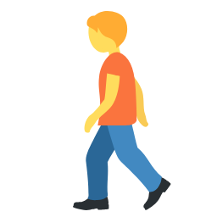
7
I walk, I don't run
Illustrations: Twemoji (github.com/jdecked/twemoji) · CC BY 4.0 licence: creativecommons.org/licenses/by/4.0/

Slide 10
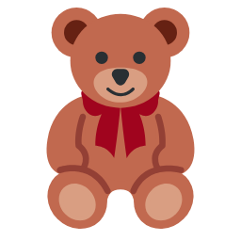
8
I take care of things
Illustrations: Twemoji (github.com/jdecked/twemoji) · CC BY 4.0 licence: creativecommons.org/licenses/by/4.0/

