Slide 1



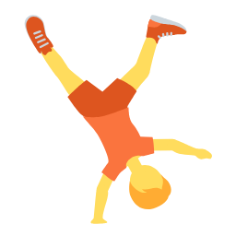
The class visual timetable
Activity cards to plan the day
Contents:
· 40 activity cards to cut out
· 5 weekday headers
· Ideal with velcro or magnets on the board
Print on A4 and cut along the dotted lines. Recommended: laminate to reuse.
Illustrations: Twemoji (github.com/jdecked/twemoji) · CC BY 4.0 licence: creativecommons.org/licenses/by/4.0/

Slide 2
Guide for teachers and families
WHO IT IS FOR
Preschool and early primary (ages 3-8). Very useful for children who need to know what comes next, newcomer classes and special education.
GOALS
· Make the day predictable and ease anxiety.
· Make children independent in routines.
· Introduce the days of the week.
ACTIVITIES WITH PROGRESSION
Getting started
Hang the day header and order the morning cards together at circle time. Remove each card when the activity ends.
Consolidation
Let a child (the helper) order and remove the cards.
Extension
Add times to each card or prepare tomorrow's timetable before going home.
Print on A4, cut out, laminate and put velcro or magnets on the back. Works best on the board or on a wall display at the children's eye level.
Illustrations: Twemoji (github.com/jdecked/twemoji) · CC BY 4.0 licence: creativecommons.org/licenses/by/4.0/

Slide 3
Monday
Tuesday
Wednesday
Thursday
Friday
Illustrations: Twemoji (github.com/jdecked/twemoji) · CC BY 4.0 licence: creativecommons.org/licenses/by/4.0/

Slide 4





Arrival
Morning snack
Playtime
Lunch
Afternoon snack
Home time
Story time
Reading
Illustrations: Twemoji (github.com/jdecked/twemoji) · CC BY 4.0 licence: creativecommons.org/licenses/by/4.0/

Slide 5

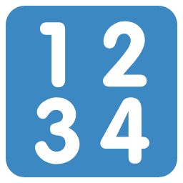





Writing
Maths
English
Music
PE
Art
Science
Computing
Illustrations: Twemoji (github.com/jdecked/twemoji) · CC BY 4.0 licence: creativecommons.org/licenses/by/4.0/

Slide 6



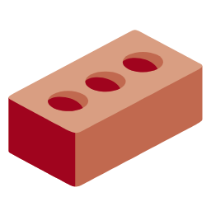


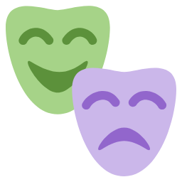
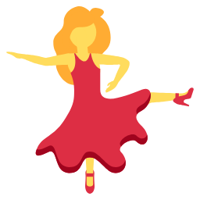
Tutor time
Circle time
Play corner
Construction
Library
Field trip
Drama
Dance
Illustrations: Twemoji (github.com/jdecked/twemoji) · CC BY 4.0 licence: creativecommons.org/licenses/by/4.0/

Slide 7








Relaxation
Handwashing
Toilet
Water break
Birthday party
Language
Project work
Homework
Illustrations: Twemoji (github.com/jdecked/twemoji) · CC BY 4.0 licence: creativecommons.org/licenses/by/4.0/

Slide 8


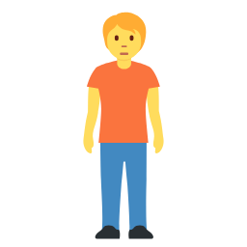





Assessment
Quiet time
Lining up
Tidy-up time
Gardening
Cooking
Board games
Video time
Illustrations: Twemoji (github.com/jdecked/twemoji) · CC BY 4.0 licence: creativecommons.org/licenses/by/4.0/

