Slide 1




Transport cards
Illustrated vocabulary to cut out and sort
Contents:
· 24 transport cards to cut out
· Sorting mat: land, air and sea
· Suggested age: 3-8 years
Print on A4 and cut along the dotted lines. Recommended: laminate to reuse.
Illustrations: Twemoji (github.com/jdecked/twemoji) · CC BY 4.0 licence: creativecommons.org/licenses/by/4.0/

Slide 2
Guide for teachers and families
WHO IT IS FOR
Preschool and early primary (ages 3-8). Transport vocabulary.
GOALS
· Grow transport vocabulary in English.
· Sort by where they travel: land, air or sea.
· Reason about sorting criteria and discuss them.
ACTIVITIES WITH PROGRESSION
Starter level
Name each vehicle with the card. Then show only the word and guess which one it is.
Intermediate level
The sorting mat: place the cards on the Land / Air / Sea page. Any debatable cases? Talk about them.
Advanced level
Count how many wheels each vehicle has and order them. Or think up routes: 'how would we get from Barcelona to Havana?'
Print on A4, cut out and laminate. The sorting mat works best laminated on the floor or on a table.
Illustrations: Twemoji (github.com/jdecked/twemoji) · CC BY 4.0 licence: creativecommons.org/licenses/by/4.0/

Slide 3




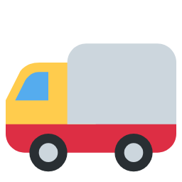





car
taxi
bus
tram
train
underground
lorry
tractor
ambulance
fire engine
police car
bike
Illustrations: Twemoji (github.com/jdecked/twemoji) · CC BY 4.0 licence: creativecommons.org/licenses/by/4.0/

Slide 4
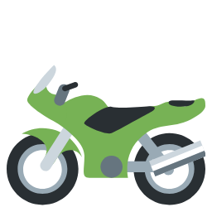









motorbike
scooter
plane
helicopter
rocket
ship
ferry
boat
canoe
cable car
hot air balloon
skateboard
Illustrations: Twemoji (github.com/jdecked/twemoji) · CC BY 4.0 licence: creativecommons.org/licenses/by/4.0/

Slide 5
Sort the cards by where they travel
Land
Air
Sea
Illustrations: Twemoji (github.com/jdecked/twemoji) · CC BY 4.0 licence: creativecommons.org/licenses/by/4.0/

