Slide 1




Weather and seasons
Cards for the daily routine and an observatory poster
Contents:
· 17 weather and season cards to cut out
· "What's the weather like today?" poster
· Suggested age: 3-8 years
Print on A4 and cut along the dotted lines. Recommended: laminate to reuse.
Illustrations: Twemoji (github.com/jdecked/twemoji) · CC BY 4.0 licence: creativecommons.org/licenses/by/4.0/

Slide 2
Guide for teachers and families
WHO IT IS FOR
Preschool and early primary (ages 3-8). Daily weather routine and seasons unit.
GOALS
· Name the weather each day.
· Connect weather, seasons and the right clothes.
· Observe and record changes over the year.
ACTIVITIES WITH PROGRESSION
Starter level
Morning routine: look out of the window and the helper hangs the weather card on the poster.
Intermediate level
Sort: which cards can happen in each season? Are there rainy days in summer?
Advanced level
Keep a weekly weather record and count: which weather has had the most days this month?
Print on A4, cut out, laminate and use velcro on the poster. The poster works all year on the circle-time wall.
Illustrations: Twemoji (github.com/jdecked/twemoji) · CC BY 4.0 licence: creativecommons.org/licenses/by/4.0/

Slide 3



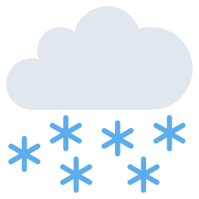


sun
cloud
sun and cloud
rain
storm
snow
wind
fog
rainbow
Illustrations: Twemoji (github.com/jdecked/twemoji) · CC BY 4.0 licence: creativecommons.org/licenses/by/4.0/

Slide 4







tornado
heat
cold
umbrella
spring
summer
autumn
winter
Illustrations: Twemoji (github.com/jdecked/twemoji) · CC BY 4.0 licence: creativecommons.org/licenses/by/4.0/

Slide 5
What's the weather like today?
sun
cloud
sun and cloud
rain
storm
snow
wind
fog
rainbow
tornado
heat
cold
umbrella
Illustrations: Twemoji (github.com/jdecked/twemoji) · CC BY 4.0 licence: creativecommons.org/licenses/by/4.0/

